Slide 1

Chapter 8 Security
Computer Networking: A Top-Down Approach 8th edition Jim Kurose, Keith Ross Pearson, 2020
Acknowledgement: Based on the textbook’s website: https://gaia.cs.umass.edu/kurose_ross/index.php
Notes:
Version History
8.0 (May 2020)
All slides reformatted for 16:9 aspect ratio
All slides updated to 8th edition material
Use of Calibri font, rather that Gill Sans MT
Add LOTS more animation throughout
lighter header font
wireless security completely redone (updated WiFi and added 4G/5G)
SSL material replaces by TLS 1.3 (up-to-date)
V8.2 (Feb 2022)
Minor corrections

Slide 2

Chapter 8 outline
What is network security?
Principles of cryptography
Authentication, message integrity
Securing e-mail
Securing TCP connections: TLS
Network layer security: IPsec
Security in wireless and mobile networks
Operational security: firewalls and IDS

Slide 3
Transport-layer security (TLS)
widely deployed security protocol above the transport layer
supported by almost all browsers, web servers: https (port 443)
provides:
confidentiality: via symmetric encryption
integrity: via cryptographic hashing
authentication: via public key cryptography
all techniques we have studied!
history:
early research, implementation: secure network programming, secure sockets
secure socket layer (SSL) deprecated [2015]
TLS 1.3: RFC 8846 [2018]

Slide 4
Transport-layer security (TLS)
widely deployed security protocol above the transport layer
supported by almost all browsers, web servers: https (port 443)
provides:
confidentiality: via symmetric encryption
integrity: via cryptographic hashing
authentication: via public key cryptography
all techniques we have studied!
history:
early research, implementation: secure network programming, secure sockets
secure socket layer (SSL) deprecated [2015]
TLS 1.3: RFC 8846 [2018]

Slide 5
Transport-layer security: what’s needed?
let’s build a toy TLS protocol, t-tls, to see what’s needed!
we’ve seen the “pieces” already:
handshake: Alice, Bob use their certificates, private keys to authenticate each other, exchange or create shared secret
key derivation: Alice, Bob use shared secret to derive set of keys
data transfer: stream data transfer: data as a series of records
not just one-time transactions
connection closure: special messages to securely close connection

Slide 6


t-tls: initial handshake
t-tls handshake phase:
Bob establishes TCP connection with Alice
Bob verifies that Alice is really Alice
Bob sends Alice a master secret key (MS), used to generate all other keys for TLS session
potential issues:
3 RTT before client can start receiving data (including TCP handshake)
TCP SYN
SYNACK
ACK
t-tls hello
public key certificate
K_{B}⁺(MS) = EMS
client request
server reply

Slide 7
t-tls: cryptographic keys
considered bad to use same key for more than one cryptographic function
different keys for message authentication code (MAC) and encryption
four keys:
K_{c} : encryption key for data sent from client to server
M_{c} : MAC key for data sent from client to server
K_{s} : encryption key for data sent from server to client
M_{s} : MAC key for data sent from server to client
keys derived from key derivation function (KDF)
takes master secret and (possibly) some additional random data to create new keys

Slide 8
t-tls: encrypting data
recall: TCP provides data byte stream abstraction
Q: can we encrypt data in-stream as written into TCP socket?
A: where would MAC go? If at end, no message integrity until all data received and connection closed!
solution: break stream in series of “records”
each client-to-server record carries a MAC, created using M_{c}
receiver can act on each record as it arrives
t-tls record encrypted using symmetric key, K_{c,} passed to TCP:
K_{c}(
)
length
data
MAC

Slide 9
t-tls: encrypting data (more)
possible attacks on data stream?
re-ordering: man-in middle intercepts TCP segments and reorders (manipulating sequence #s in unencrypted TCP header)
replay
solutions:
use TLS sequence numbers (data, TLS-seq-# incorporated into MAC)
use nonce

Slide 10
t-tls: connection close
truncation attack:
attacker forges TCP connection close segment
one or both sides thinks there is less data than there actually is
solution: record types, with one type for closure
type 0 for data; type 1 for close
MAC now computed using data, type, sequence #
K_{c}(
)
length
type
data
MAC

Slide 11
Transport-layer security (TLS)
TLS provides an API that any application can use
an HTTP view of TLS:
HTTP 1.0
HTTP/2
HTTP/2 (slimmed)
Application
HTTP/3
TLS
QUIC
Transport
TCP
TCP
UDP
Network
IP
IP
IP
HTTP/2 over TCP
HTTP/2 over TCP
HTTP/2 over QUIC
(which incorporates TLS)
over UDP

Slide 12
TLS: 1.3 cipher suite
“cipher suite”: algorithms that can be used for key generation, encryption, MAC, digital signature
TLS: 1.3 (2018): more limited cipher suite choice than TLS 1.2 (2008)
only 5 choices, rather than 37 choices
requires Diffie-Hellman (DH) for key exchange, rather than DH or RSA
combined encryption and authentication algorithm (“authenticated encryption”) for data rather than serial encryption, authentication
4 based on AES
HMAC uses SHA (256 or 284) cryptographic hash function

Slide 13

TLS 1.3 handshake: 1 RTT
1
client TLS hello msg:
guesses key agreement protocol, parameters
indicates cipher suites it supports
client hello:
supported cipher suites
DH key agreement protocol, parameters
1
2
server TLS hello msg chooses
key agreement protocol, parameters
cipher suite
server-signed certificate
server hello:
selected cipher suite
DH key agreement protocol, parameters
2
3
3
client:
checks server certificate
generates key
can now make application request (e.g.., HTTPS GET)
client
server

Slide 14
TLS 1.3 handshake: 0 RTT
initial hello message contains encrypted application data!
“resuming” earlier connection between client and server
application data encrypted using “resumption master secret” from earlier connection
vulnerable to replay attacks!
maybe OK for get HTTP GET or client requests not modifying server state
client hello:
supported cipher suites
DH key agreement protocol, parameters
application data
server hello:
selected cipher suite
DH key agreement protocol, parameters
application data (reply)
client
server

Slide 15
Chapter 8 outline
What is network security?
Principles of cryptography
Authentication, message integrity
Securing e-mail
Securing TCP connections: TLS
Network layer security: IPsec
Security in wireless and mobile networks
Operational security: firewalls and IDS

Slide 16
IP Sec
provides datagram-level encryption, authentication, integrity
for both user traffic and control traffic (e.g., BGP, DNS messages)
two “modes”:
payload
payload
payload
tunnel mode:
entire datagram is encrypted, authenticated
encrypted datagram encapsulated in new datagram with new IP header, tunneled to destination
transport mode:
only datagram payload is encrypted, authenticated

Slide 17
Two IPsec protocols
Authentication Header (AH) protocol [RFC 4302]
provides source authentication & data integrity but not confidentiality
Encapsulation Security Protocol (ESP) [RFC 4303]
provides source authentication, data integrity, and confidentiality
more widely used than AH

Slide 18
Security associations (SAs)
before sending data, security association (SA) established from sending to receiving entity (directional)
ending, receiving entitles maintain state information about SA
recall: TCP endpoints also maintain state info
IP is connectionless; IPsec is connection-oriented!
200.168.1.100
193.68.2.23
SA
R1 stores for SA:
32-bit identifier: Security Parameter Index (SPI)
origin SA interface (200.168.1.100)
destination SA interface (193.68.2.23)
type of encryption used
encryption key
type of integrity check used
authentication key

Slide 19
IPsec datagram
authenticated
encrypted
new IP header
ESP
header
original IP hdr
Original IP
datagram payload
ESP
trailer
ESP
auth
tunnel mode
ESP
SPI
Seq
#
padding
pad length
next header
ESP trailer: padding for block ciphers
ESP header:
SPI, so receiving entity knows what to do
sequence number, to thwart replay attacks
MAC in ESP auth field created with shared secret key

Slide 20
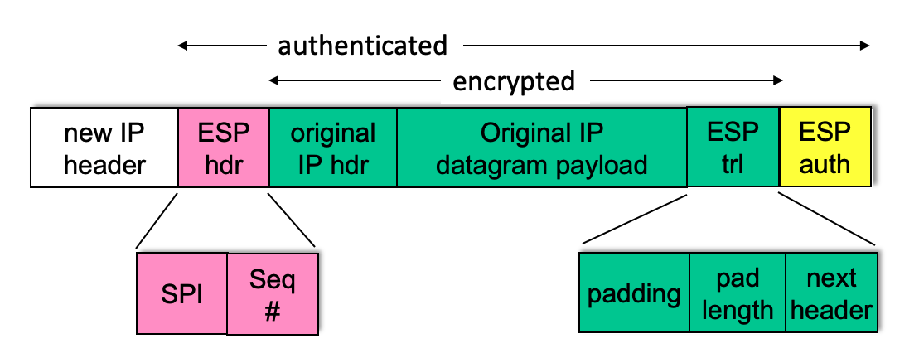
ESP tunnel mode: actions
payload
at R1:
appends ESP trailer to original datagram (which includes original header fields!)
encrypts result using algorithm & key specified by SA
appends ESP header to front of this encrypted quantity
creates authentication MAC using algorithm and key specified in SA
appends MAC forming payload
creates new IP header, new IP header fields, addresses to tunnel endpoint
R1
payload

Slide 21
IPsec sequence numbers
for new SA, sender initializes seq. # to 0
each time datagram is sent on SA:
sender increments seq # counter
places value in seq # field
goal:
prevent attacker from sniffing and replaying a packet
receipt of duplicate, authenticated IP packets may disrupt service
method:
destination checks for duplicates
doesn’t keep track of all received packets; instead uses a window

Slide 22
Security Policy Database (SPD)
IPsec security databases
Security Assoc. Database (SAD)
endpoint holds SA state in security association database (SAD)
when sending IPsec datagram, R1 accesses SAD to determine how to process datagram
when IPsec datagram arrives to R2, R2 examines SPI in IPsec datagram, indexes SAD with SPI, processing
datagram accordingly.
policy: for given datagram, sender needs to know if it should use IP sec
policy stored in security policy database (SPD)
needs to know which SA to use
may use: source and destination IP address; protocol number
SAD: “how” to do it
SPD: “what” to do

Slide 23

Summary: IPsec services
Trudy sits somewhere between R1, R2. she doesn’t know the keys
will Trudy be able to see original contents of datagram? How about source, dest IP address, transport protocol, application port?
flip bits without detection?
masquerade as R1 using R1’s IP address?
replay a datagram?

Slide 24
IKE: Internet Key Exchange
previous examples: manual establishment of IPsec SAs in IPsec endpoints:
Example SA:
SPI: 12345
Source IP: 200.168.1.100
Dest IP: 193.68.2.23
Protocol: ESP
Encryption algorithm: 3DES-cbc
HMAC algorithm: MD5
Encryption key: 0x7aeaca…
HMAC key:0xc0291f…
manual keying is impractical for VPN with 100s of endpoints
instead use IPsec IKE (Internet Key Exchange)

Slide 25
IKE: PSK and PKI
authentication (prove who you are) with either
pre-shared secret (PSK) or
with PKI (pubic/private keys and certificates).
PSK: both sides start with secret
run IKE to authenticate each other and to generate IPsec SAs (one in each direction), including encryption, authentication keys
PKI: both sides start with public/private key pair, certificate
run IKE to authenticate each other, obtain IPsec SAs (one in each direction).
similar with handshake in SSL.

Slide 26
IKE phases
IKE has two phases
phase 1: establish bi-directional IKE SA
note: IKE SA different from IPsec SA
aka ISAKMP security association
phase 2: ISAKMP is used to securely negotiate IPsec pair of SAs
phase 1 has two modes: aggressive mode and main mode
aggressive mode uses fewer messages
main mode provides identity protection and is more flexible

Slide 27
IPsec summary
IKE message exchange for algorithms, secret keys, SPI numbers
either AH or ESP protocol (or both)
AH provides integrity, source authentication
ESP protocol (with AH) additionally provides encryption
IPsec peers can be two end systems, two routers/firewalls, or a router/firewall and an end system

